Slide 1
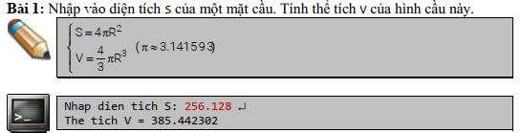
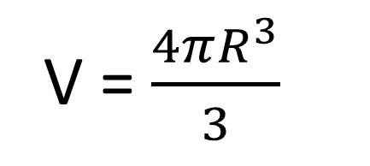
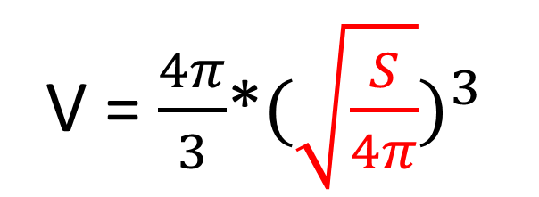

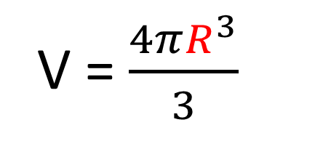

Phân tích đề
S = $4πR^{2}$
V = $\frac{4π}{3}$*${(\sqrt{\frac{S}{4π}})}^{3}$
R = $\sqrt{\frac{S}{4π}}$
V = $\frac{4πR^{3}}{3}$
V = $\frac{4πR^{3}}{3}$
#include<math.h>
Return value | Code include math.h
Double | M_PI = 3.14159
Double | double sqrt(double x)
Double | double pow(double x, double y)
Link: | https://vietjack.com/thu-vien-c/math-h-trong-c.jsp

